Slide 1

DEPARTMENT OF COMPUTER SCIENCE AND ENGINEERING
PROJECT NAME: Smart Public Restroom
TEAM NAME: Proj_224780_Team_2
TEAM MEMBERS:
MOHITHA LAKSHMI N S(113321104062)
MONIKA D(113321104063)
NAGALAKSHMI M(113321104064)
NAIDU K SUJITHA S KUMAR(113321104065)

Slide 2
PROJECT
Creating a smart public restroom using IoT (Internet ofThings) involves a combination ofhardware, software, and connectivity. While web development technologies may not be the only requirement, they can play a crucial role in creating a user interface for monitoring and controlling the smart restroom system.

Slide 3
AI FOR SMART PUBLIC RESTROOM
1. Occupancy Monitoring: AI can be used to monitor restroom occupancy in real-time using sensors or cameras. This data can be made available to users through mobile apps, helping them find available facilities quickly.
2. Cleaning Scheduling: AI can analyze restroom usage patterns to optimize cleaning schedules. This ensures that restrooms are clean when they are most likely to be used.
3. Maintenance Alerts: Sensors and AI algorithms can detect issues like clogged toilets or broken faucets and alert maintenance staff in real-time, reducing downtime.
4. Touchless Interfaces: Implement touchless interfaces for flushing toilets, operating faucets, and dispensing soap and paper towels to reduce the spread of germs.
5. Energy Efficiency: AI can optimize lighting and HVAC systems to save energy when restrooms are not in use.
6. Language Support: Implement multilingual voice interfaces to help users who speak different languages to navigate and use the facilities.

Slide 4
ADS FOR SMART PUBLIC RESTROOM
1. Digital Displays: Install digital screens or interactive displays in the restroom area to showcase ads. These displays can be used for video ads, promotions, or public service announcements.
2. Sensors for Ad Triggers: Use sensors to trigger ads based on user behavior or patterns. For example, an ad for a nearby restaurant might be displayed when someone spends a certain amount of time in the restroom.
3. QR Code Promotions: Provide QR codes in the restroom area that users can scan to access exclusive deals or promotions from local businesses.
4. Audio Ads: Incorporate audio ads or announcements within the restroom facilities. This can include voice ads played through speakers or through smart restroom audio systems.
5. Augmented Reality (AR): Implement AR experiences for restroom users. For instance, users could scan an AR code on the restroom mirror to see an interactive ad or product demonstration.
6. Targeted Advertising: Utilize AI and user data to display targeted ads based on demographic information, user preferences, and previous behaviors within the facility.

Slide 5
DAC FOR SMART PUBLIC RESTROOM
1. Noise Monitoring: DAC systems can use microphones strategically placed within the restroom to monitor noise levels. If noise exceeds a certain threshold, the system can trigger actions such as sending alerts to security or staff to address disruptive behavior.
2. Privacy and Safety: DAC can be used to protect privacy and enhance safety. For example, it can detect distress sounds or unauthorized entry, immediately alerting security personnel or relevant authorities.
3.Energy Efficiency: They can also work in tandem with HVAC systems to reduce noise and energy consumption when restrooms are not heavily used.
4.Data Analytics: DAC can provide data and insights on acoustic patterns within the facility, which can be valuable for optimizing restroom operations and improving user experience.
5.Voice Assistance: If integrated with voice assistants, DAC systems can provide users with information, answer questions, and offer audio-based guidance within the restroom.
6.Emergency Notifications: DAC systems can be integrated with emergency notification systems to broadcast important announcements or safety instructions in the event of an emergency.

Slide 6
IOT FOR SMART PUBLIC RESTROOM
1. Occupancy Monitoring: IoT sensors and cameras can track restroom occupancy in real-time, helping users find available facilities. This data can also be used to optimize cleaning schedules.
2. Smart Water Management: IoT devices can monitor water usage, detect leaks, and adjust water flow in toilets, sinks, and urinals to conserve water and reduce costs.
3. Touchless Interfaces: IoT-enabled touchless fixtures, like faucets, soap dispensers, and hand dryers, reduce the need for physical contact and enhance hygiene.
4. Automatic Sanitization: IoT systems can schedule and trigger automatic cleaning and disinfection processes, ensuring that restrooms are consistently sanitary.
5. Energy Efficiency: IoT sensors can regulate lighting, heating, ventilation, and air conditioning (HVAC) systems based on occupancy, saving energy when the restroom is unoccupied.
6. Waste Management: IoT-connected waste bins can signal when they need emptying, optimizing waste collection routes and reducing labor costs.

Slide 7
CAD FOR SMART PUBLIC RESTROOM
1. Space Planning: CAD software helps architects and designers efficiently plan the layout of the restroom, ensuring that fixtures, partitions, and entryways are optimally arranged for accessibility and functionality.
2. Fixture Placement: CAD allows for precise placement of toilets, sinks, urinals, hand dryers, and other fixtures, taking into account building codes and accessibility requirements.
3. Ventilation and HVAC: CAD assists in designing ventilation and HVAC systems to ensure proper air circulation, temperature control, and energy efficiency within the restroom.
4. Electrical Layout: CAD can be used to design the electrical layout, including the placement of lighting fixtures, outlets, and switches for optimal visibility and user safety.
5. Plumbing Design: CAD helps in the design of plumbing systems, ensuring efficient water supply and drainage for fixtures, including the placement of pipes and sewage connections.
6. Accessibility Compliance: CAD software can be used to design restrooms that comply with accessibility standards, including the layout of accessible stalls, grab bars, and clearance requirements.

Slide 8
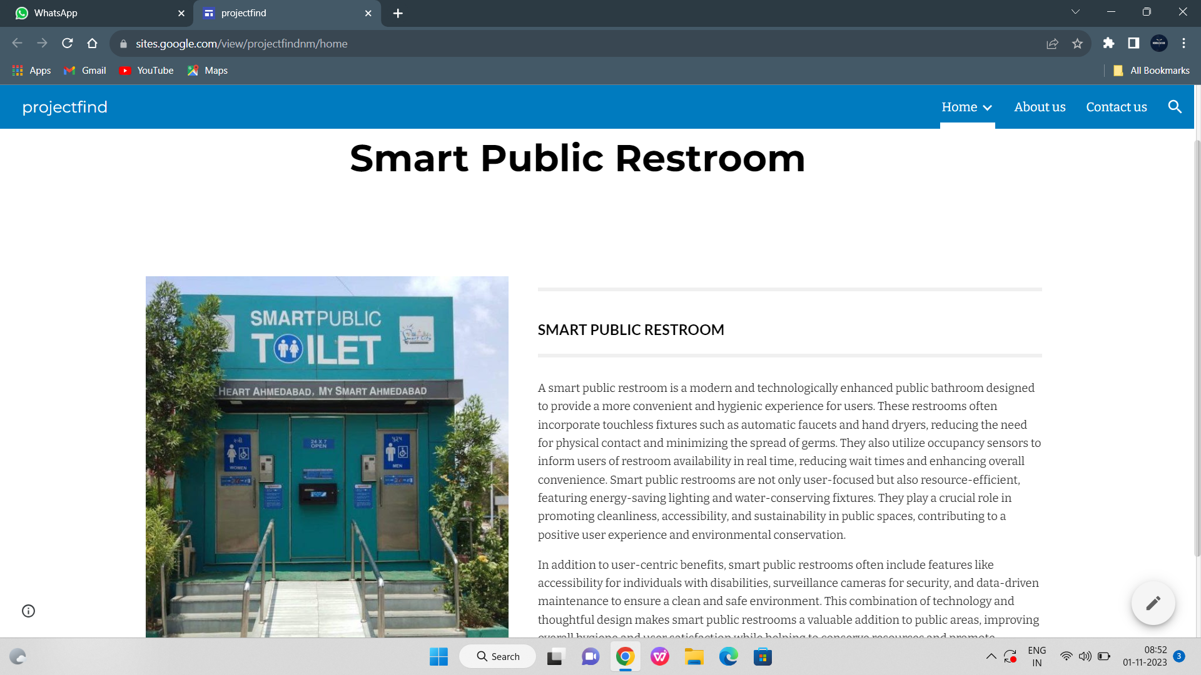
Click here to check our website

Slide 9
CONCLUSION
Smart public restrooms represent a significant advancement in enhancing public facilities. Through the integration of IoT and AI technologies, these facilities offer a range of benefits, from touchless fixtures that improve hygiene to resource-efficient operations that promote sustainability. Notably, smart restrooms provide a more accessible and user-friendly experience with features like occupancy monitoring and queue management. However, their successful implementation requires careful planning and collaboration among architects, designers, engineers, and technology providers. Ultimately, smart public restrooms exemplify the potential of technology to enhance everyday experiences and better serve the public.

Slide 10
THANK YOU

